Slide 1
Technological Revolutions
and Finance Capital:
the Dynamics of Bubbles and Golden ages (Ch 7~10)
STP510 Yunji Woo

Slide 2
0. Table of Contents
Financial capital and Production capital
1
Maturity Phase
2
Irruption Phase
3
Frenzy Phase
4

Slide 3
1-1. Financial Capital and Production Capital
Investment
Financial Capital
Production Capital
Possess wealth in form of money to increase wealth
Generate new wealth by producing goods or performing services
Reallocating and Redistributing wealth
Accumulate greater profit-making capacity tied to concrete products
Invest in firm and project without much knowledge
Based on knowledge on the product, process, and market
Profit

Slide 4
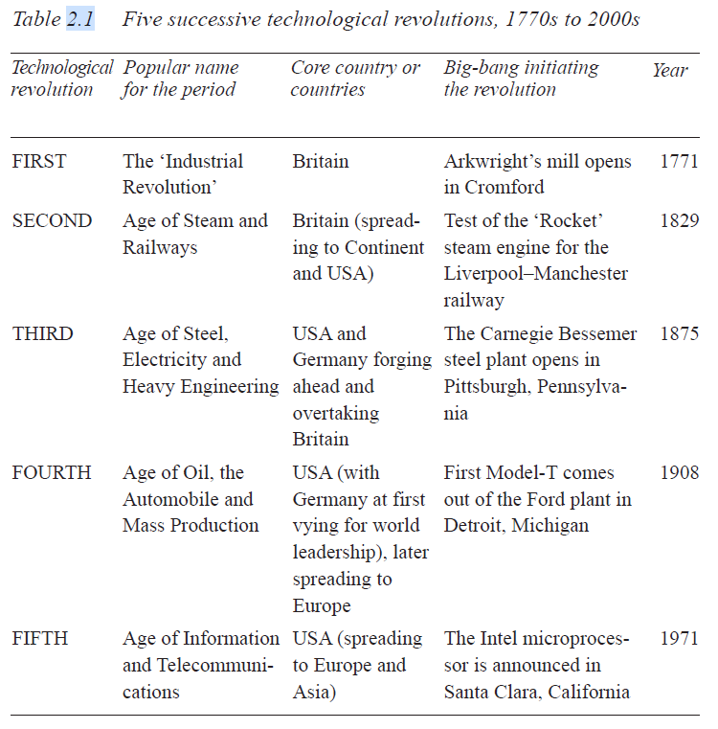
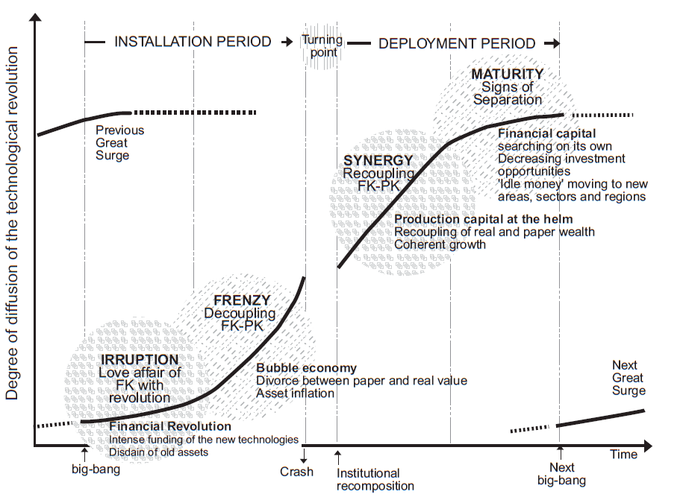
1-1. Financial Capital and Production Capital
1771
1829
1875
1908
1971
1
2
3
4
5
Industrial Revolution
Stream and Railways
Steel, Electricity, Engineering
Oil, Automobile, Mass production
Information and Telecommunications

Slide 5
1-2. The Changing relationship between financial and production capital
Irruption phase
Technological revolution Big-bang
New entrepreneurs outstrip the profit-making potential.
Rush of financial capital plays to help spread the revolution
idle money in search of profitable use

Slide 6
1-2. The Changing relationship between financial and production capital
Decoupling in the frenzy phase
Massive creative destruction
Financial capital
Convinced its capacity of generating wealth.
Production capital
New paradigm for new products, processes and services as well as for rejuvenating the old

Slide 7
1-2. The Changing relationship between financial and production capital
The turning point
The end of frenzy phase bring implosion of bubble
Reckoning and acceptance, regulation is put to financial capital
Re-established connection with production capital

Slide 8
1-2. The Changing relationship between financial and production capital
Synergy phase: The period of Deployment
Recoupling of financial and production capital
Production capital wealth-creator
Financial capital as a Facilitator
Innovation and growth take place across the whole productive spectrum

Slide 9
1-2. The Changing relationship between financial and production capital
Trouble again in maturity
Production capital
Begin to reach limit to growth in productivity and market
Firms preserve profits for investment as idle money
Financial capital
Look around for other profitable new technologies
Next technological revolution emerges

Slide 10
Financial Capital Planting the seeds of
Turbulence at the end of the previous surge
2. Maturity Phase

Slide 11
2-0. Maturity Phase
Maturity
Maturity is the end of the development period.
Exhaustion of original core industries of the prevailing paradigm.
Old industries find difficulties to increase productivity or markets.
Begin spreading Geographically, reaching for peripheral markets or for lower-cost production.
Financial capitals support flourishing the last sectors, and attempt to their threatened profits.
Now become huge and faces difficulty in finding fruitful investment for their mass of profit.
Pushes them into buying up smaller competitors to increase market share, trying untested technologies for stretching their trajectories and venturing into distant markets or production locations.
1771
1829
1875
1908
1971
1
2
3
4
5
Industrial Revolution
Stream and Railways
Steel, Electricity, Engineering
Oil, Automobile, Mass production
Information and Telecommunications

Slide 12
2-1. Power-Seeking Behavior
Maturity
Blue chip strategy
Financial capital support strongest production capital
Closely attached to the production clients(or partners)
Powerful firms increase market control
Squeezing out of the market
Buying up smaller competitors to create closed oligopolies
Acquire firms in other sectors to build diversified giants
1771
1829
1875
1908
1971
1
2
3
4
5
Industrial Revolution
Stream and Railways
Steel, Electricity, Engineering
Oil, Automobile, Mass production
Information and Telecommunications

Slide 13
2-2. Redeployment: Investing away from the Core Countries and Sectors
Maturity
Financial capital starts Redeployment for stretching of business possibilities
Support investment in marginalized sectors (Sectors)
Sales to new distant clients (Investment)
Moving of production to cheaper location (Geographic)
Overflows of investment to peripheries
Catching-up processes in countries that are ready for it
Catching-up efforts of lagging countries
1771
1829
1875
1908
1971
1
2
3
4
5
Industrial Revolution
Stream and Railways
Steel, Electricity, Engineering
Oil, Automobile, Mass production
Information and Telecommunications

Slide 14
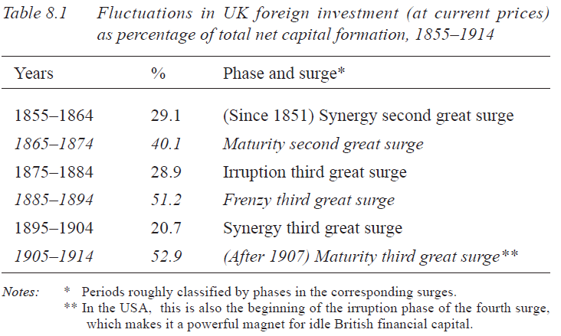
2-2. Redeployment: Investing away from the Core Countries and Sectors
Maturity
Irruption and Synergy: Investment concentrates on domestic firms
Frenzy and Maturity: Capital migration

Slide 15
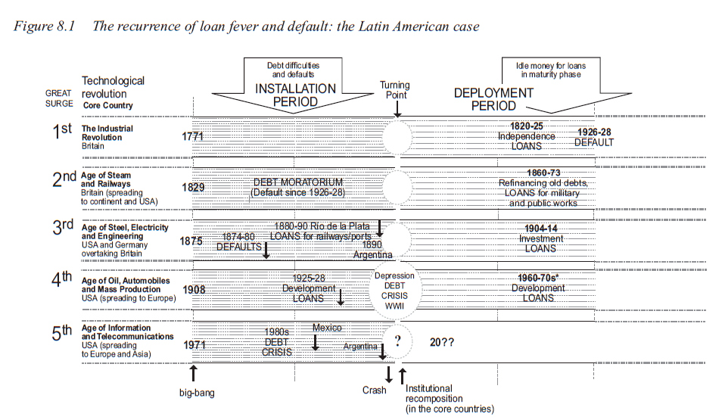
2-3. Idle Money Leads to Bad Loans
Maturity
Loans are granted to weaker creditors
The creation of great volumes of sovereign dept, that nurtures future debt crises
ex) Latin America: recurring cycle of loan fever in maturity phase, and default during the process of paradigm shift.

Slide 16
The love affair of financial capital
with the technological revolution
3. Irruption Phase

Slide 17
3-0. Irruption Phase
Irruption
Coexistence of two paradigms; Old and New
The present scheme the final phase of life cycle of a paradigm
Initial phase of the next technological evolution
Financial capital is still intensively engaged in old, but the appearance of new territory is very quickly realized
Idle capital rapidly engages to support new industries and entrepreneurs
Financial capital and banking jump to the quick adoption of modernizing innovation for their own operations
1771
1829
1875
1908
1971
1
2
3
4
5
Industrial Revolution
Stream and Railways
Steel, Electricity, Engineering
Oil, Automobile, Mass production
Information and Telecommunications

Slide 18
3-1. New ‘Risk Capital’ Instruments
Irruption
Requirement of Financial support
The pioneers could break the new ground on their own
However, the expansion and the continuing momentum require substantial support from the financial system
The role of finance is determined by the specific characteristics of innovation
1) Industrial Revolution in England
One-time funding requests for mechanization of cotton industry
2) Development of the railways
Required the great quantities of investment, that were rarely available from a single firm.
Joint-stock companies concentrated capital, spread the risks, and
made diffusion of innovation.
1771
1829
1875
1908
1971
1
2
3
4
5
Industrial Revolution
Stream and Railways
Steel, Electricity, Engineering
Oil, Automobile, Mass production
Information and Telecommunications

Slide 19
3-1. New ‘Risk Capital’ Instruments
Irruption
3) Age of Steel: Banking and institutionalized financial capital became a powerful and indispensable part of the industrial system
Allow the emergence of new entrepreneurs
Opens a window of opportunity for catching-up countries and regions
Outspreading of capital to distant places from the maturity phase incorporates them into the range of action of financial capital and makes various ventures possible.
Private capital & State involvement
ex) Japan in 1960s and 1970s
ex) US Railway 40% funding was put up by state governments
“The shift of power from the industrial to the finance capitalist came when the expansion of industry reached a size beyond the resources of individual entrepreneurs or banks, and when the movement for consolidation reached a stage where the services of a central investment house became necessary to handle the finance involved.” – Harold Faulkner

Slide 20
3-2. Funding the rejuvenation of old core branches
Irruption
Idle money in hands of production capital
Powerful firms of the previous revolution often acting as oligopolies
The funds used for geographic redeployment are reinvested
The old core firms become agents in the construction, diffusion, and installation of the new techno-economic paradigm.
Expecting all investment to be profitable
New industries and infrastructures continue to gather momentum in this period and are growing and diffusing at an amazing pace
1771
1829
1875
1908
1971
1
2
3
4
5
Industrial Revolution
Stream and Railways
Steel, Electricity, Engineering
Oil, Automobile, Mass production
Information and Telecommunications

Slide 21
Self-sufficient financial capital
governing the Casino
4. Frenzy Phase

Slide 22
4-0. Frenzy phase
Frenzy
Frenzy is period of extremely unbalanced prosperity and of polarization
The Decoupling of Financial and production capital
Producing firms may bend their decisions to provide high short-term gains required by the stock market
General behavior of the economy is increasingly geared to favoring the multiplication of financial capital
1771
1829
1875
1908
1971
1
2
3
4
5
Industrial Revolution
Stream and Railways
Steel, Electricity, Engineering
Oil, Automobile, Mass production
Information and Telecommunications

Slide 23
4-1. Speculating with Old Wealth: Asset inflation
Frenzy
Financial capital invented and applied to make more wealth out of existing wealth
Indirectly tied to production
Taking control over the operating firms, building ‘inverted pyramids’
Hedge funds, junk bonds, and other instruments serve to bring in capital for a wider than usual range of investment.
‘Bring everybody into an investor’
Diverting finance from wealth creation and simply find other investment
ex) Real estate
Notion of ‘fundamentals’ is set aside and price/earning ratio argument out of all proportions.
1771
1829
1875
1908
1971
1
2
3
4
5
Industrial Revolution
Stream and Railways
Steel, Electricity, Engineering
Oil, Automobile, Mass production
Information and Telecommunications

Slide 24
4-2. Crises in the Weaker Nodes of the World Economy
Frenzy
Widening Social Gaps
Transformation and wealth creation with the installation of infrastructure to new paradigm
The industries, countries, regions and firms that have not taken the modernization path, are entering a vicious spiral of low growth and lack of funds
“Rich get richer and poor get poorer”
The risk of default in lagging sectors
The weaker countries that received the idle money in the previous periods are fragile
Leading to increasing foreign control over the already battered wealth-generating capability of economics, weakens them in their debt-paying capacity
1771
1829
1875
1908
1971
1
2
3
4
5
Industrial Revolution
Stream and Railways
Steel, Electricity, Engineering
Oil, Automobile, Mass production
Information and Telecommunications

Slide 25
4-3. Windows of Opportunity for Catching up
Frenzy
Catching up where the behavior of financial capital, from the maturity phase through the installation period, plays a particularly important part.
National, international, historical and geographic reasons, to make a catching-up leap with new paradigm.
ex) Asian Tigers: Geopolitical forces of Cold War to facilitate a wave of foreign investment
ex) Argentina before the Baring crisis in 1890: Steam-powered and refrigerated shipping technology made Argentina to become a supplier for northern hemisphere.
Latecomer economies are naturally more fragile, vulnerable to sudden retrieval of funds
Severely affected by the shrinking of markets
1771
1829
1875
1908
1971
1
2
3
4
5
Industrial Revolution
Stream and Railways
Steel, Electricity, Engineering
Oil, Automobile, Mass production
Information and Telecommunications

Slide 26
4-4. Manias and Frantic Competition
Frenzy
Frenzied and confusing atmosphere of the casino economy
Huge trial and error process eventually to affect the whole of society
Market experience irregular chaotic growth and intense investment can lead to overcapacity problems
General disorder and lack of coordination in investment decision
‘Trillion dollar scrap-heap’ telecommunications investment in late 1990s – Dan Roberts, The Financial Times
Mania leading to panic collapse
1798, canal mania
1847, railway mania
1929, real estate and stock market mania
1990s, Internet mania
1771
1829
1875
1908
1971
1
2
3
4
5
Industrial Revolution
Stream and Railways
Steel, Electricity, Engineering
Oil, Automobile, Mass production
Information and Telecommunications

Slide 27
Technological Revolution
and Financial Bubbles
5. Sum-Up

Slide 28
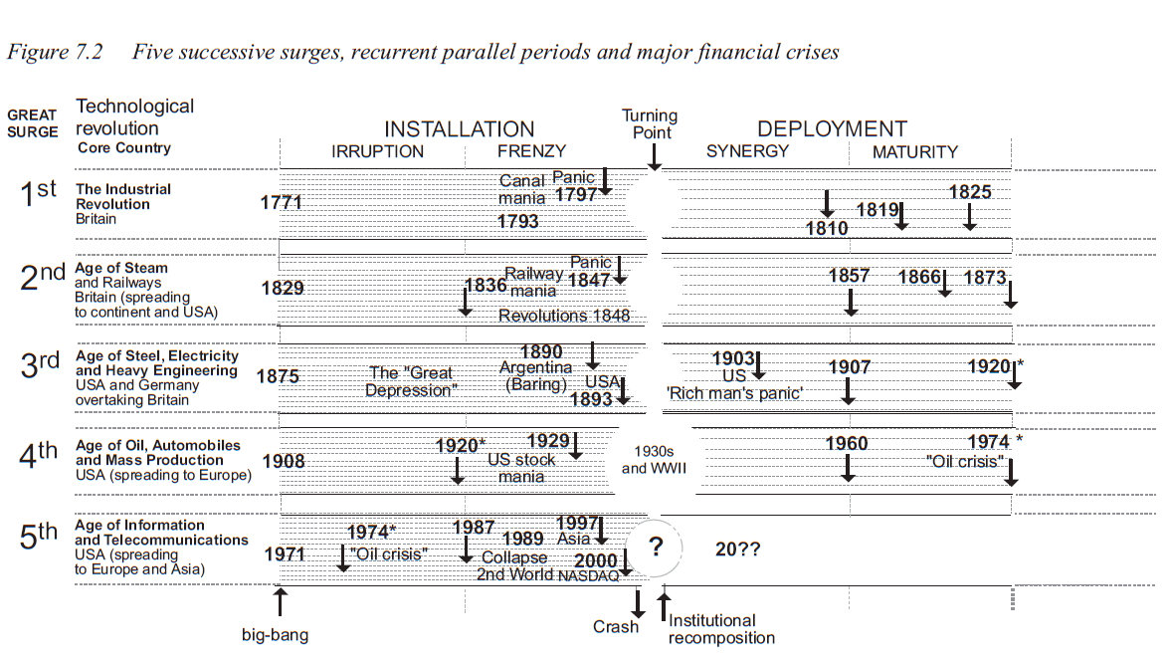
5. Technological Life Cycle Chain
Who are responsible in the economic collapse?
How could states or international governments associations control the financial default? Is it even available?

